Slide 1
Stock Prediction Model
Clay Roberts, Pete Acevedo, Pedro Alvarado, Awaleh Houssein, Mateo Rivas

Slide 2
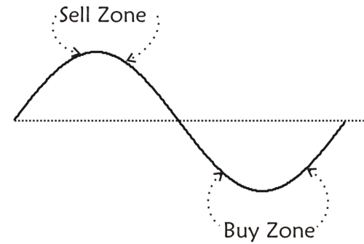
Introduction
The stock market is a system that offers participants the ability to buy and sell portions of ownership in an organization.
In return a participant’s investments increases or decreases depending on the organizations success.
Traders work to predict the market and optimize individual gains by buying and selling stock the moment before a stock swings positive or negative.
Stock prediction models work to identify complex relationships that influence the behavior of a stock, allowing a market participant to invest in anticipation of a desired outcome.

Slide 3
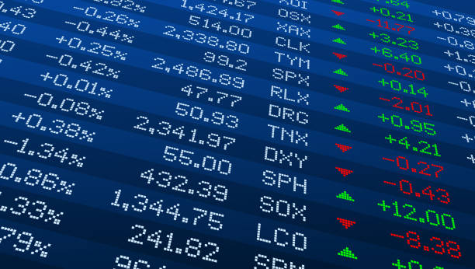
Research Problem
Stocks are affected by a plethora of factors including illogical human reaction and emotion. Some of which make things like predicting the behavior of stocks inherently difficult.
The research problem we address in this iteration of our project is the short term prediction of stock prices in spite of these factors, using a variety of machine learning methods.
Notes:
https://www.istockphoto.com/illustrations/stock-market

Slide 4
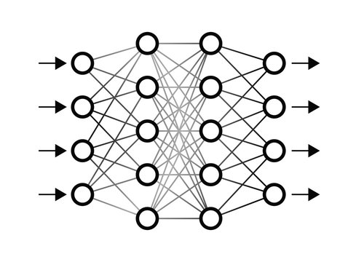
Methods
Long Short Term Memory (LSTM)
Recurrent Neural Network (RNN) that sequentially captures dependencies between data points.
Moving Average Time Series
Model that forecasts performance using historical data.
Self-Attention
A technique that eliminates the sequential nature of RNNs and allows for parallelization of relationship identification
Notes:
https://stock.adobe.com/images/neural-network-illustration/179895957

Slide 5
ARIMA and Time Series
Time series forecasting is the process of analyzing time series data using statistics and modeling to make predictions and inform strategic decision-making.
Time series forecasting is useful for prediction of data that spans over a period of time. We used it for stock prediction in particular to try and predict how NVIDIA stock would move over time. Hence the time series aspect of it.
Our particular model is called the ARIMA model and we achieved accuracy of up to 71% in some of our predictions.
Autoregressive Integrated Moving Average (ARIMA) combines three components - autoregression, integration, and moving averages to model time series data.
Autoregression (AR) uses a regression model that utilizes the dependent relationship between current values and lagged values of a time series.
Integration (I) transforms non-stationary time series data into stationary data through differencing.
Moving Average (MA) models the error term as a linear combination of error terms occurring contemporaneously and at various times in the past.

Slide 6
LSTM and The Transformer
LSTM memory utilizes a RNN that maintains some “memory” of important context from information passed from node to node.
Memory is updated at each step in the network, and past and new inputs are considered.
Captures long term dependencies , which is useful for data with complex patterns.
The transformer, and more specifically self-attention allows the model grasp dependencies between inputs that are “far” apart.
A relationship map is created between input that highlights meaningful connections between their behaviors and values.
Because computations aren’t performed sequentially, self-attention allows relationships to be attended to all at once instead of relying on the previous input.

Slide 7
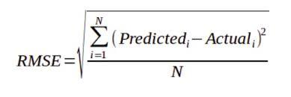
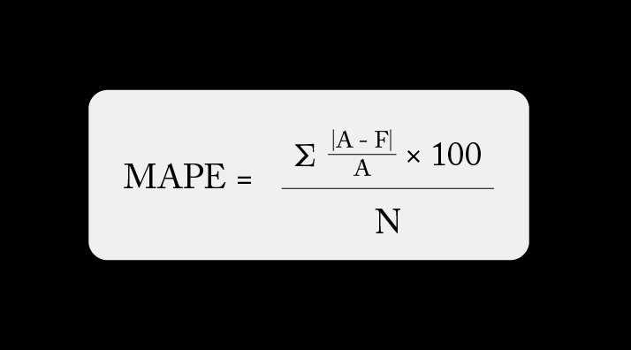
Experimental Setup
The model will be evaluated using a two key metrics:
Mean Absolute Percentage Error (MAPE)
Average difference between predicted and actual price
Root Mean Squared Error (RMSE)
Adds focus to outlier events
Predictions were based on predicting the closing stock price a single day in the future.
Notes:
https://www.geeksforgeeks.org/root-mean-square-error-in-r-programming/
https://arize.com/blog-course/mean-absolute-percentage-error-mape-what-you-need-to-know/
https://study.com/academy/lesson/how-to-calculate-sharpe-ratio-definition-formula-examples.html

Slide 8
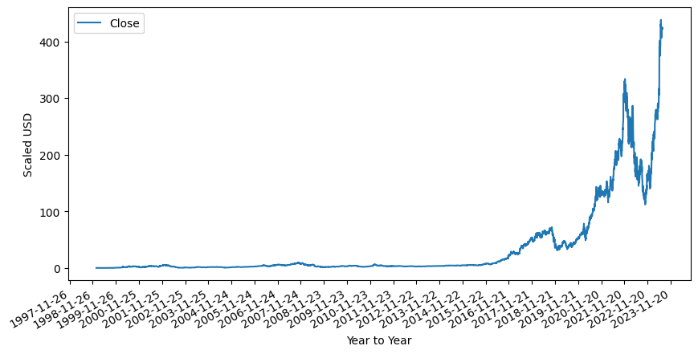
Dataset
LSTM, Moving Average, and Self-Attention were all trained and tested using NVIDIA Corporation stock performance from 1999 to 2023.
The stock performance data was gathered from yahoo finance on July 11th, 2023 as a CSV file containing the Date, Open, High, Close, Adjusted Close, and Volume of shares traded each day.
US Dollars

Slide 9
Results
Time Series:
MAPE: 0.0813
RMSE: 0.5396
LSTM 32 Neuron, Single Dense Layer, 100 Epochs:
MAPE: 0.0563
RMSE: 0.2373
Two LSTM 50 Neuron, Single Dense Layer, 100 Epochs:
MAPE: 5.0222
RMSE: 1.4836
LSTM 20 Neuron, Single Dense Layer, 20 Epochs:
MAPE: 0.0548
RMSE: 0.2495
Self-Attention:
MAPE: 0.0695
RMSE: 0.3286
Notes:
NOTE: In order to make the models all comparable, the result and testing values were all StandardScaled to have comparable RMSE. I don’t believe this should have any effect on the metrics, but it is important to note for transparency.

Slide 10
Deciphering Results
Based on the Mean Absolute Percentage Error the 20 Neuron LSTM had the lowest error.
Based on these Root Mean Square Error, the LSTM 32 Neuron, Single Dense Layer, 100 Epochs model had the highest accuracy with the 20 Neuron LSTM model as a close second.
The LSTMs with 50 neurons had interesting behavior around when the stock really started growing in price. As the actual price began to trend upward, the predicted price followed a trend line that remained flat.
Most likely due to overfitting by the model.
The training data was fairly stable, whereas the testing data had significantly more movement.

Slide 11
Challenges Faced
Training times on the Neural Networks were significant, even for the less complex models.
When training a complex LSTM model, it was very for the model to overfit, which is the case that happened with the multilayer LSTM.
Although fairly accurate predictions could be made on a short time scale, those predictions can’t be used very practically for much.
Issues would arise when trying to find previous implementation to model out code after, where the libraries used had deprecated.
The neural network output dimensionality was not always what was expect, and required analysis to extract the proper prediction value.

Slide 12
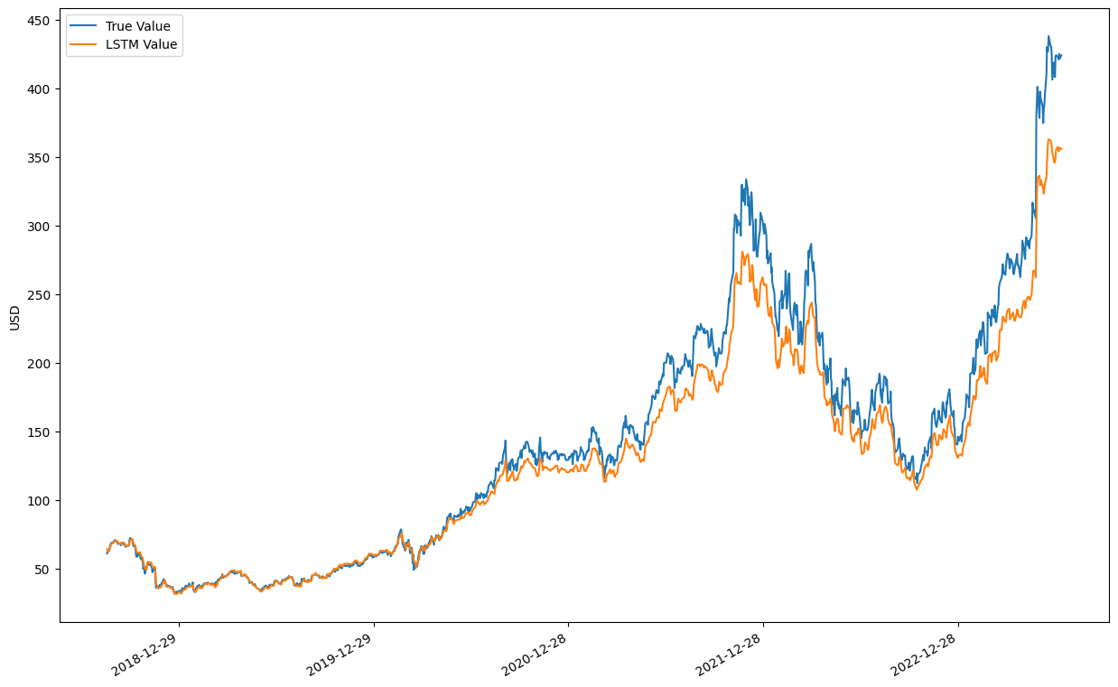
Figure 1: LSTM 32 Nodes, Single Dense Layer, 100 Epochs

Slide 13
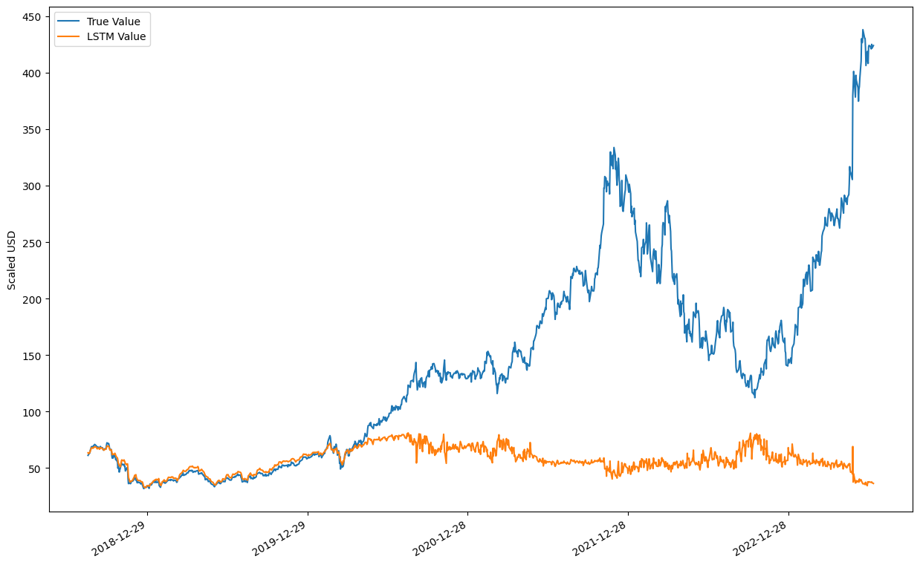
Figure 2: Two LSTM, 50 Nodes Each, Single Dense Layer, 100 Epochs

Slide 14
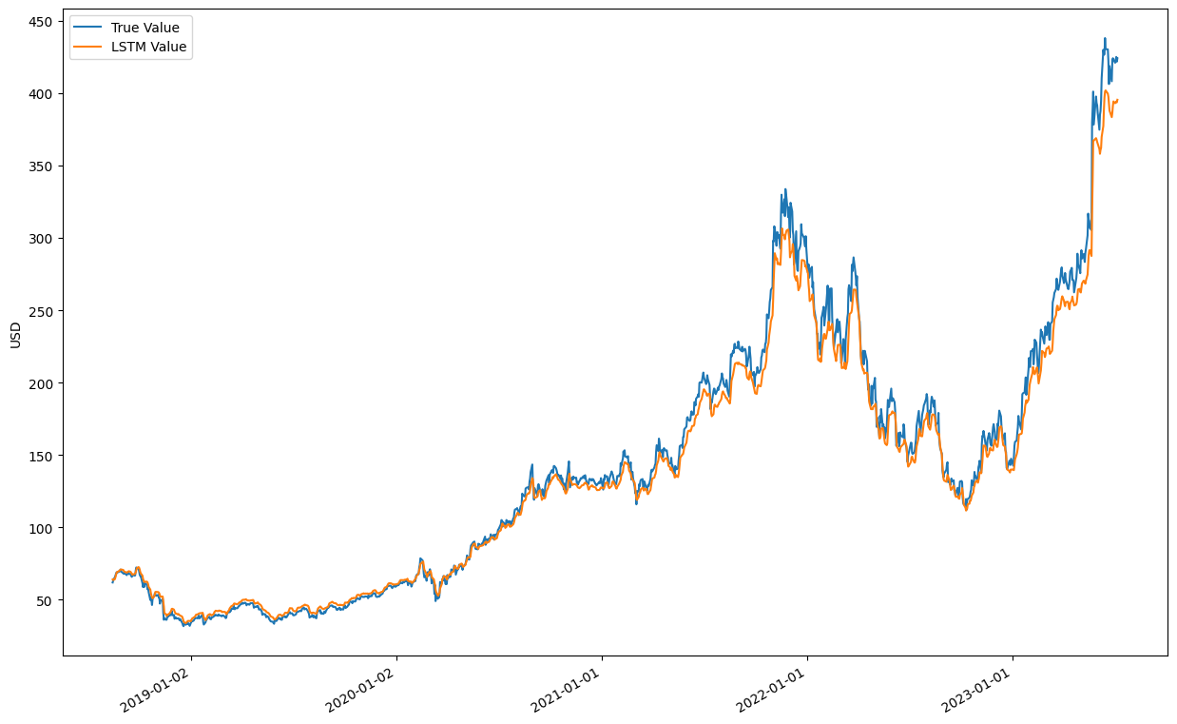
Figure 3: LSTM, 20 Nodes , Single Dense Layer, 20 Epochs

Slide 15
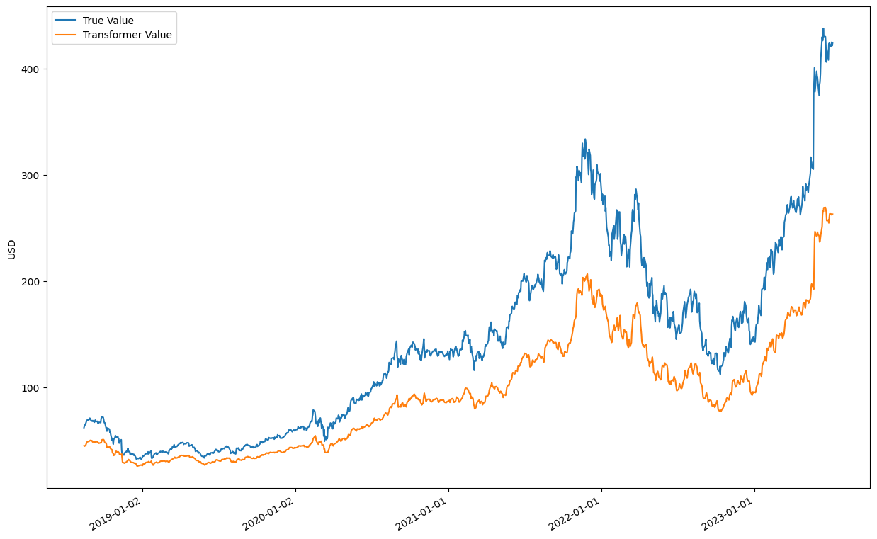
Figure 4: Self-Attention, 46 Heads

